Slide 1


Airline Reservation and Management System
Group Members:
Saleha Khurram (243529)
Abeera Shahid (243589)
Course Information:
Course Name: Database Systems
Course Code: CS130 & CS130L
Instructor Name: Mr. Muhammad Faisal Idrees
Date of Submission: 09-06-2025

Slide 2
Abstract:
This project presents the design and implementation of a comprehensive Airline Reservation and Management System for the Database Systems course. It simulates real-world airline operations: flight scheduling, passenger reservations, staff assignments, payment processing, seat allocation, and baggage handling.
Built with Microsoft SQL Server, the system follows relational database principles using ER modeling, normalization, and SQL queries (DDL & DML) to maintain data integrity, efficiency, and consistency. A robust schema of interrelated tables and realistic data enables complex queries, joins, subqueries, and aggregate functions for analytics.
This project demonstrates how databases support airline systems and strengthens our understanding of database design, querying, and solving real-world challenges.

Slide 3
Introduction:-
Purpose: Develop a robust flight reservation database.
Motivation: Enhance data integrity and streamline processes.
Importance: Databases handle large volumes of complex airline data.

Slide 4
Problem Statement:-
Manual flight bookings are slow, confusing, and error-prone. Airlines need a digital system to manage flights, reservations, passengers, seats, and baggage. Our Flight Reservation System solves this by using SQL database with a user-friendly GUI, making the booking process faster, easier, and more reliable for both admins and passengers.

Slide 5
Objectives:-
Efficient data storage
Data consistency and integrity
Complex queries for reporting
Manage flights, passengers, reservations, payments, staff

Slide 6
Database Design:-
Conceptual: ER diagram.
Logical: Normalized tables.
Physical: Implemented in SQL Server with constraints and data types.

Slide 7
Entities:-
Airline
Route
Airport
Baggage
Aircraft
Ticket
Flight
FlightStaff
Passenger
ReservationSeat
Reservation
FlightSchedule
Payment
Users
Seat
BoardingPass
Staff

Slide 8
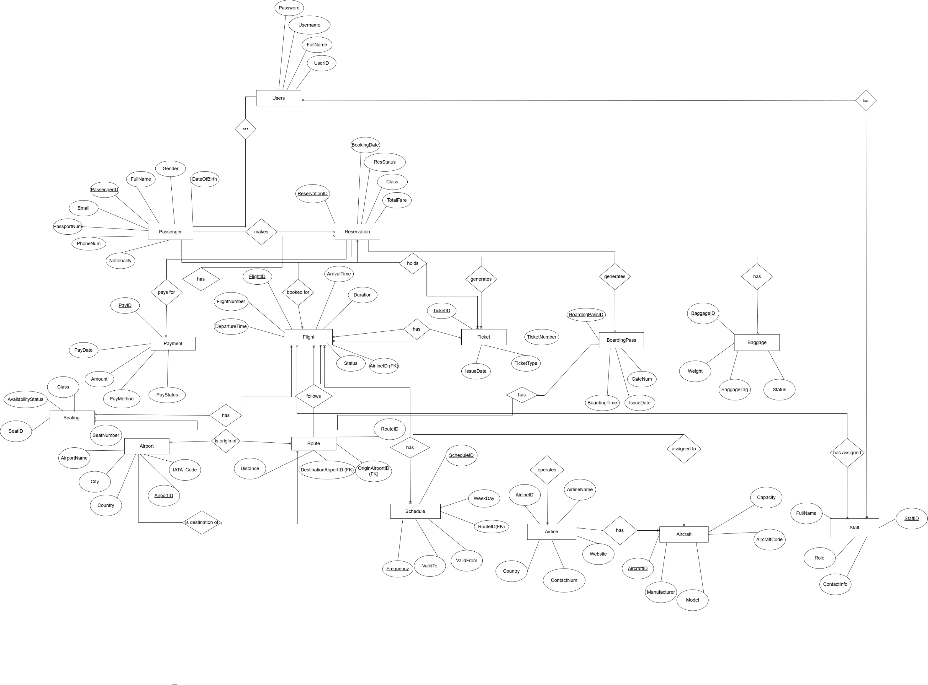
ER Diagram:-

Slide 9
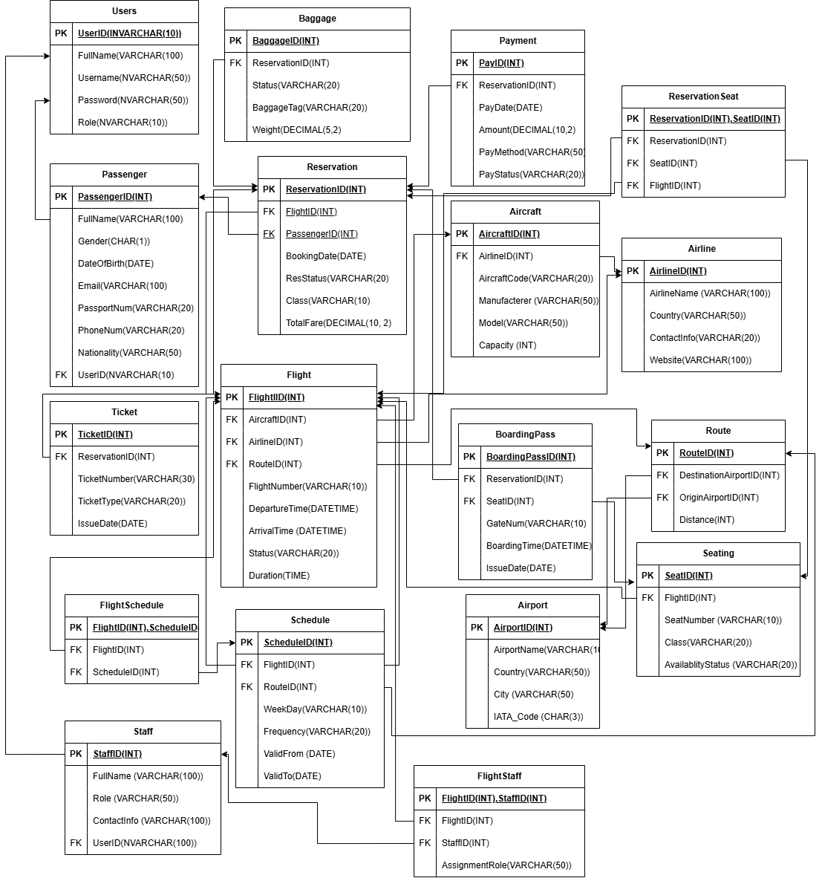
Relational Model :-

Slide 10
Queries Applied:-
Data Definition Language (DDL):
DDL stands for Data Definition Language. It's used to define or modify the structure of a database, including:
Creating
Altering or dropping tables, indexes, and other database objects.
Data Manipulation Language (DML):
DML commands are used to manipulate data in a database, including:
INSERT: Adding new data
UPDATE: Modifying existing data
DELETE: Deleting data

Slide 11

Examples:-
Query:
CREATE DATABASE [Flight Reservation System];
USE [Flight Reservation System];
Output:
-- Table to store aircraft information
CREATE TABLE Aircraft (
AircraftID INT PRIMARY KEY, -- Unique ID for the aircraft
Model VARCHAR(50) NOT NULL, -- Model name of the aircraft
Manufacturer VARCHAR(50) NOT NULL, -- Manufacturer name
Capacity INT NOT NULL, -- Seating capacity
AircraftCode VARCHAR(20) NOT NULL, -- Unique aircraft code
AirlineID INT NOT NULL -- Associated airline
);

Slide 12
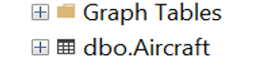
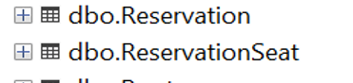
Examples (Continued):-
Query:
-- Linking table for many-to-many relationship between Reservation and Seat
CREATE TABLE ReservationSeat (
ReservationID INT NOT NULL, -- Linked reservation
SeatID INT NOT NULL, -- Linked seat
PRIMARY KEY (ReservationID, SeatID),
FOREIGN KEY (ReservationID) REFERENCES Reservation(ReservationID),
FOREIGN KEY (SeatID) REFERENCES Seat(SeatID)
);
Output:

Slide 13
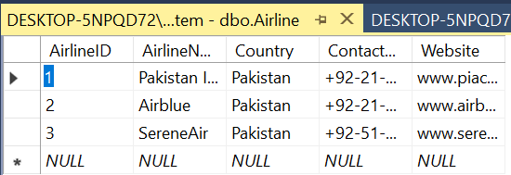
Examples (Continued):-
Insertion Query:
--Insert query for Airline
INSERT INTO Airline (AirlineID, AirlineName, Country, ContactNum, Website) VALUES
(1, 'Pakistan International Airlines', 'Pakistan', '+92-21-111-786-786', 'www.piac.com.pk'),
(2, 'Airblue', 'Pakistan', '+92-21-111-247-258', 'www.airblue.com'),
(3, 'SereneAir', 'Pakistan', '+92-51-111-737-363', 'www.sereneair.com');
Output:
In this way, data is inseterted for all other tables.

Slide 14
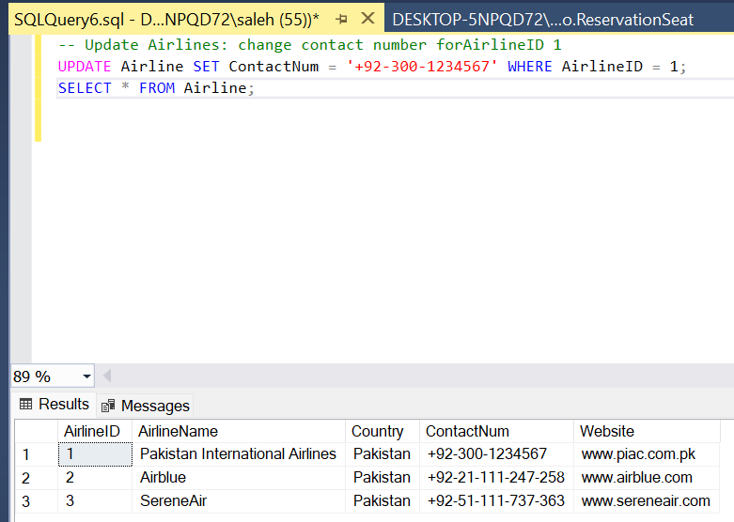
Examples (Continued):-
Update Queries:
Update queries are essential for maintaining the accuracy of data in the Flight Reservation System database. They allow modification of existing records to reflect real-time changes in operations, passenger details, and reservation status.
Output:

Slide 15
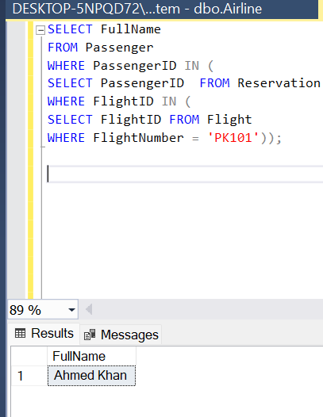
Examples (Continued):-
SubQueries:
Subqueries allow complex queries by embedding a query inside another. They help extract nested data in one operation.
Output:

Slide 16
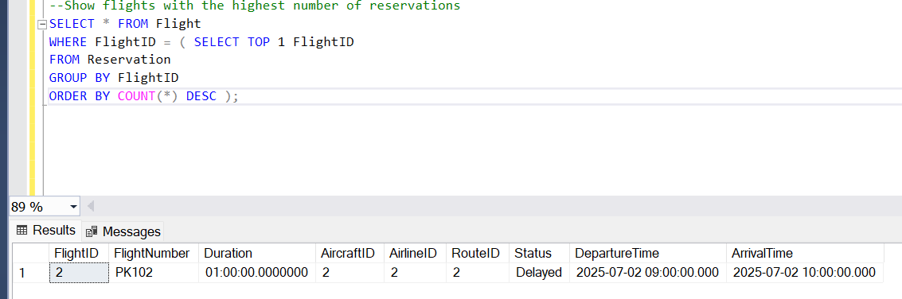
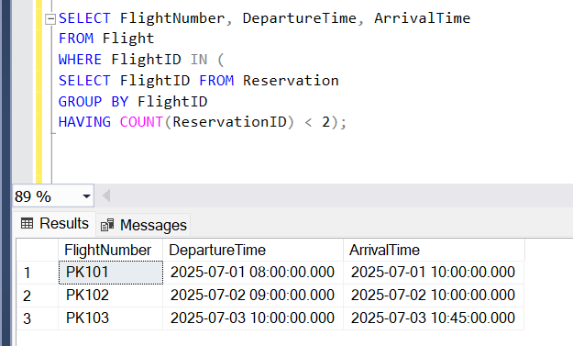
Examples (Continued):-

Slide 17
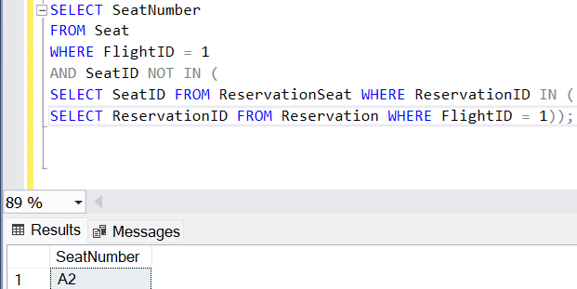
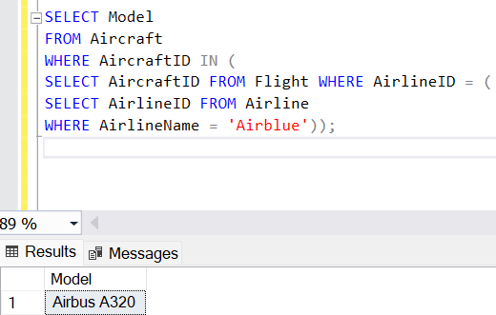
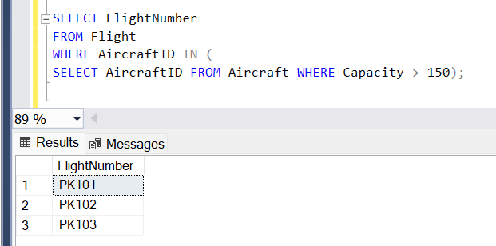
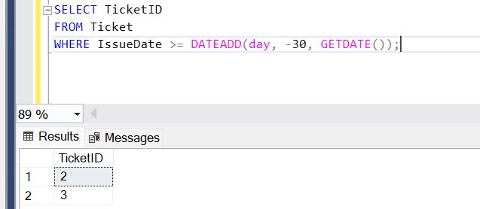
Examples (Continued):-

Slide 18
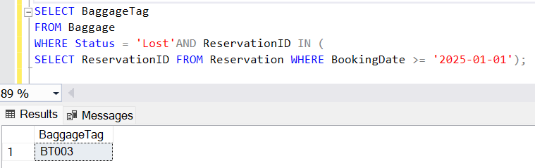
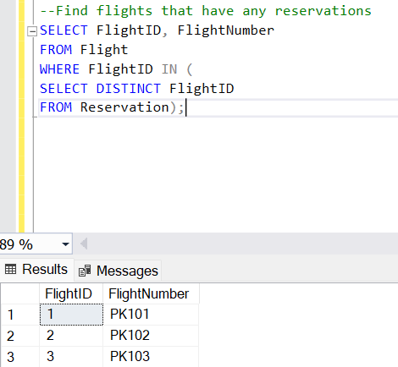
Examples (Continued):-

Slide 19
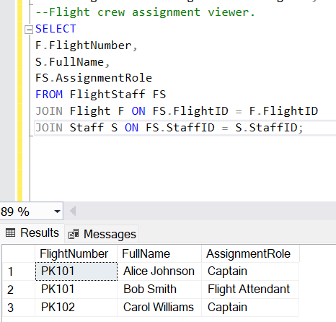
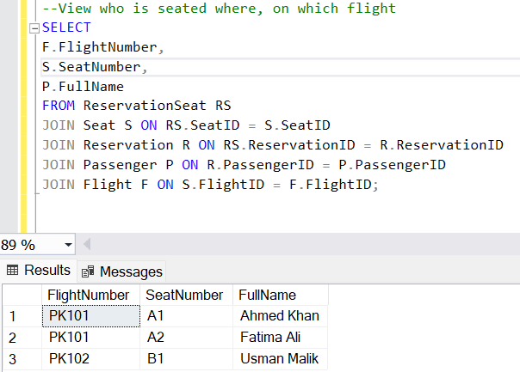
Examples (Continued):-

Slide 20
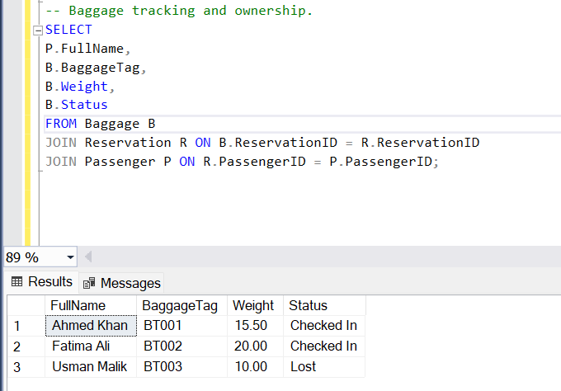
Examples (Continued):-

Slide 21
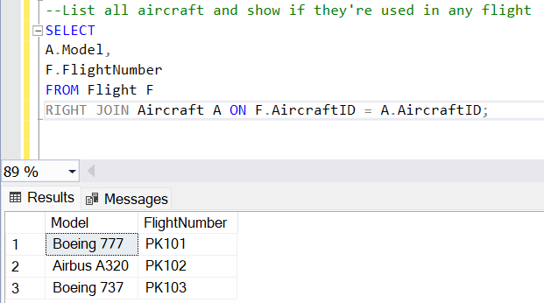
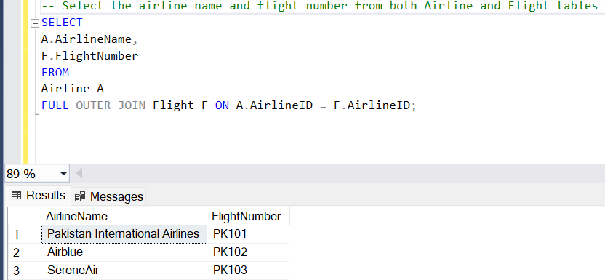
Examples (Continued):-

Slide 22
Examples (Continued):-
Aggregate Functions:
Aggregate functions are SQL functions that perform calculations on a set of values and return a single value. Common examples include:
1. SUM: Calculates the total of a set of values.
2. AVG: Calculates the average of a set of values.
3. MAX: Returns the maximum value in a set.
4. MIN: Returns the minimum value in a set.
5. COUNT: Returns the number of rows in a set.
These functions are often used in combination with GROUP BY clauses to analyze and summarize data. Aggregate functions summarize data for reports and insights.

Slide 23
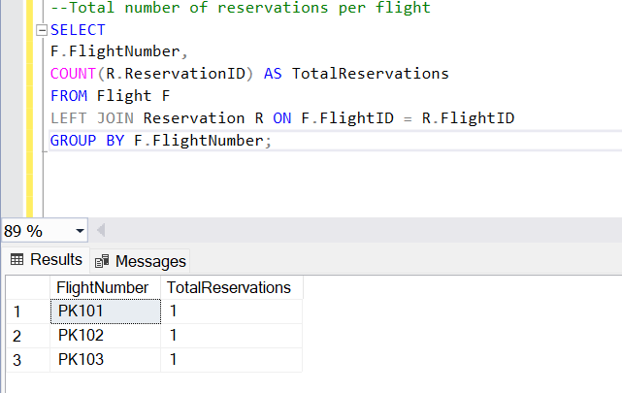
Examples (Continued):-

Slide 24
Challenges and Solutions:-
During the implementation of this database project, several challenges were faced:
Foreign Key Constraints: At times, insertion failed due to FK violations. This was resolved by ensuring referenced data existed in parent tables before inserting in child tables.
Data Type Mismatches: In some cases, incorrect data types (e.g., using VARCHAR instead of INT) caused errors. Adjusting the schema to use appropriate data types resolved these issues.
Join Errors: Incorrect or missing join conditions initially led to unexpected results. Carefully checking table relationships and modifying join conditions ensured accurate query results.
Each challenge was resolved through careful debugging, testing, and schema modifications.

Slide 25
Graphical User Interface for Airline Reservation System:-
A Graphical User Interface (GUI) is a user-friendly visual interface that allows people to interact with a computer system or software using graphical elements like buttons, forms, icons, and windows rather than text-based commands.
In the flight reservation system, the GUI includes:
Login Screen: Allows authorized users to enter credentials to access the system.
Dashboard: Serves as the main hub with navigation buttons for managing flights, passengers, and reservations.
Booking Forms: Enable staff members to add new flight bookings by filling out fields such as passenger name, flight number, and seat preferences.

Slide 26
Graphical User Interface for Airline Reservation System (Continued):-
Tables: Display available flights, booked flights, and passenger information in a structured format.
Search and Filter Tools: Help users find flights or reservations quickly by entering criteria like destination, date, or passenger name.
Edit and Delete Features: Allow authorized staff to update or remove bookings and passenger records.
Reports Module: Provides summarized data, such as the number of bookings in a day or the most popular flights.
The GUI interacts directly with the database.

Slide 27
Graphical User Interface for Airline Reservation System (Continued):-
Main Page:
This image displays the initial "MainPage" of the Flight Reservation System. It presents two primary options to the user: "Sign Up" and "Log In." This page serves as the entry point for new users to register and for existing users to access the system

Slide 28
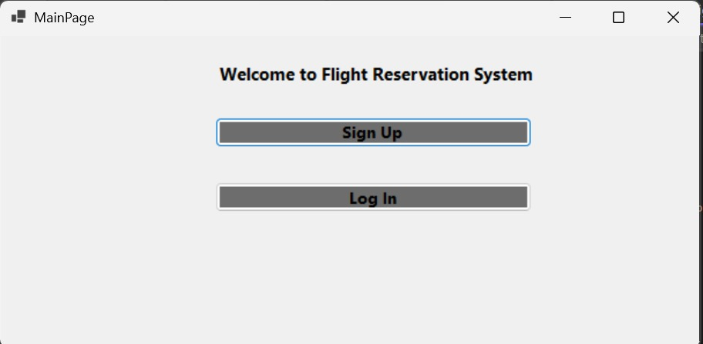
Graphical User Interface for Airline Reservation System:-

Slide 29
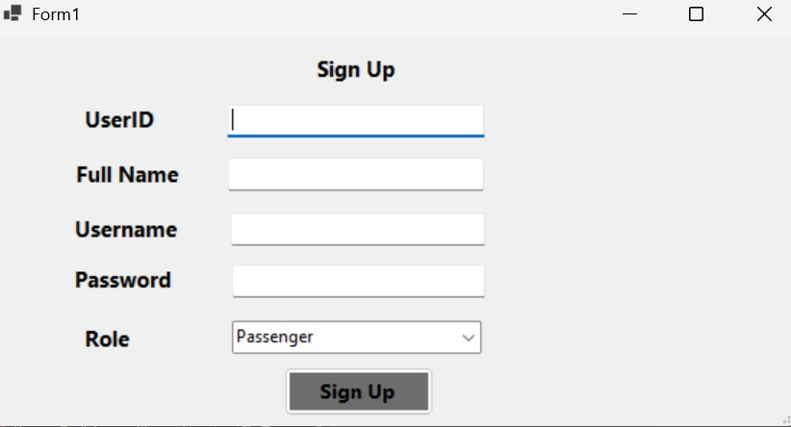
Sign-up Form:
First time users need to sign up, once registered they can then log in. The image given below shows what it does.

Slide 30
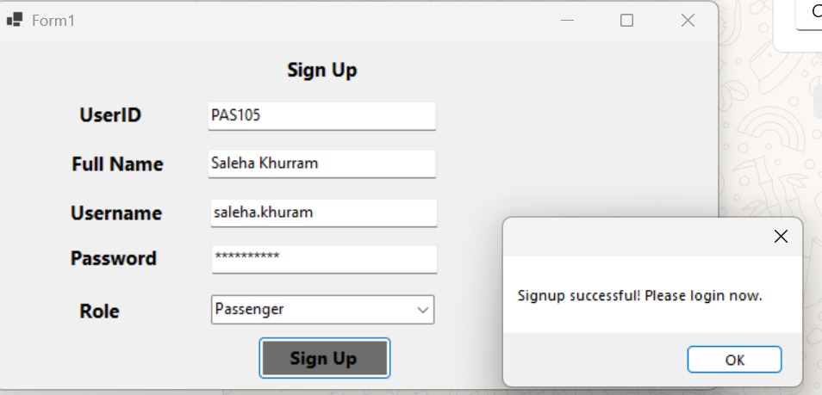

Slide 31
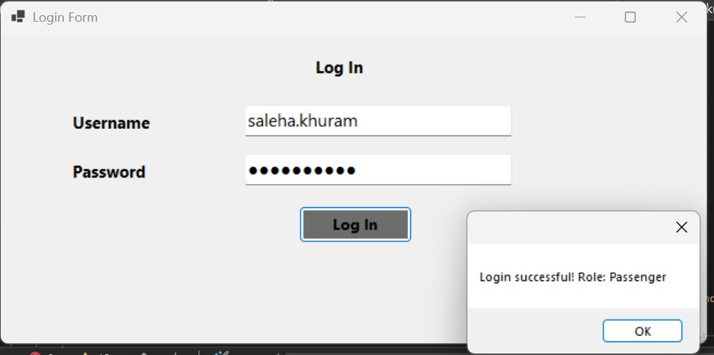

Slide 32
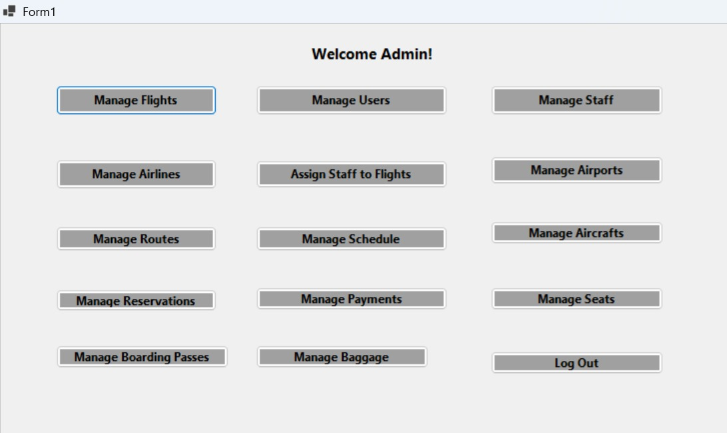
Admin Page:
This "Welcome Admin!" page (Form1) suggests a successful login by an administrator. It presents a comprehensive set of management options,

Slide 33
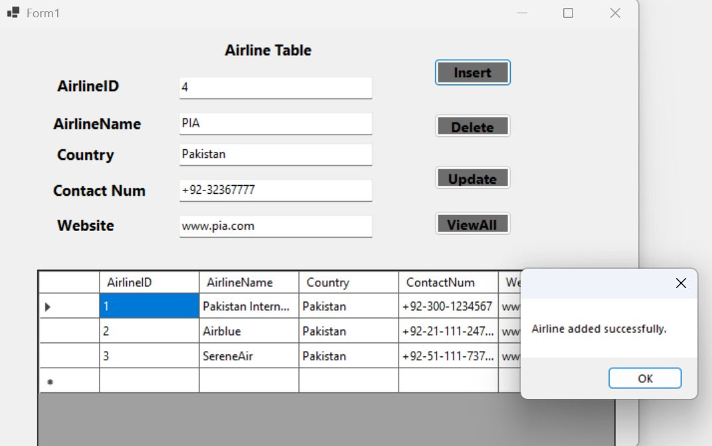
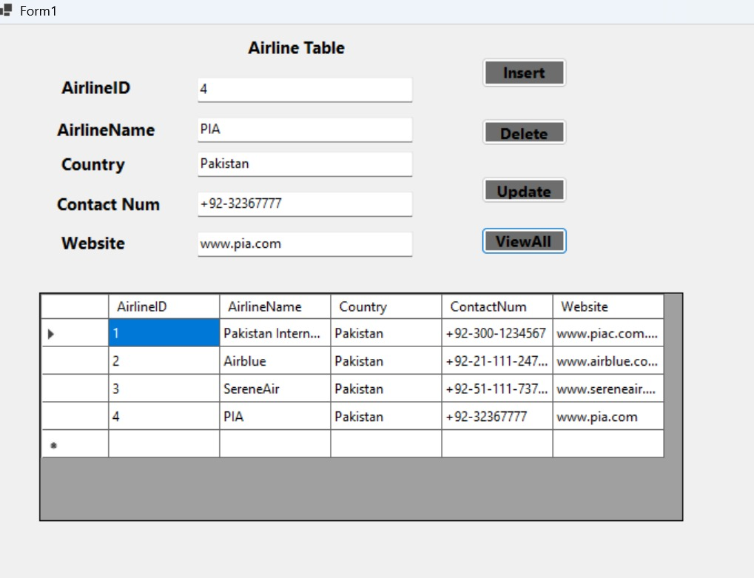

Slide 34
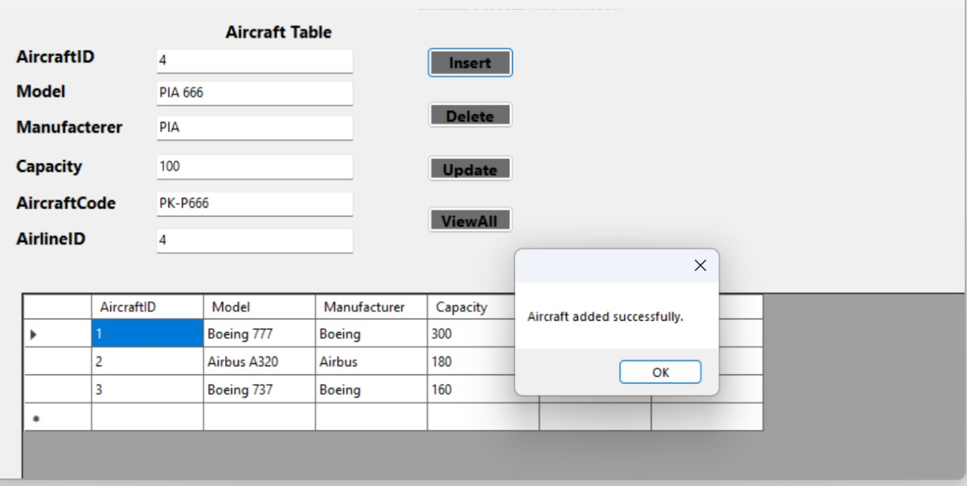
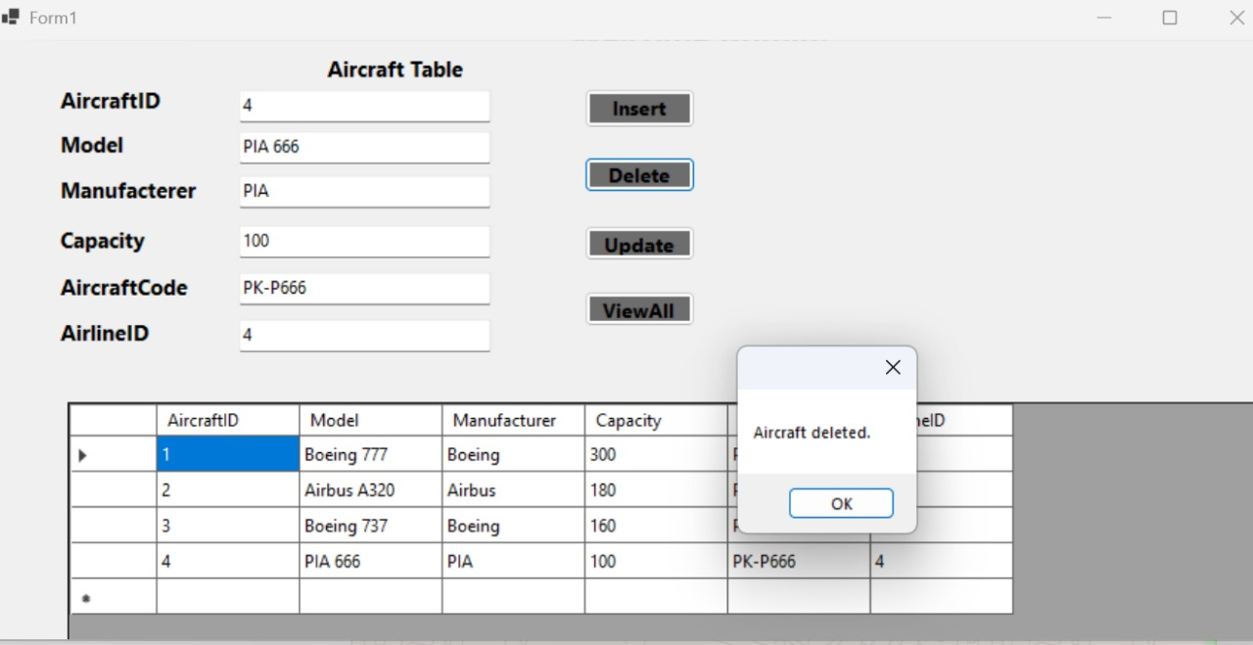

Slide 35
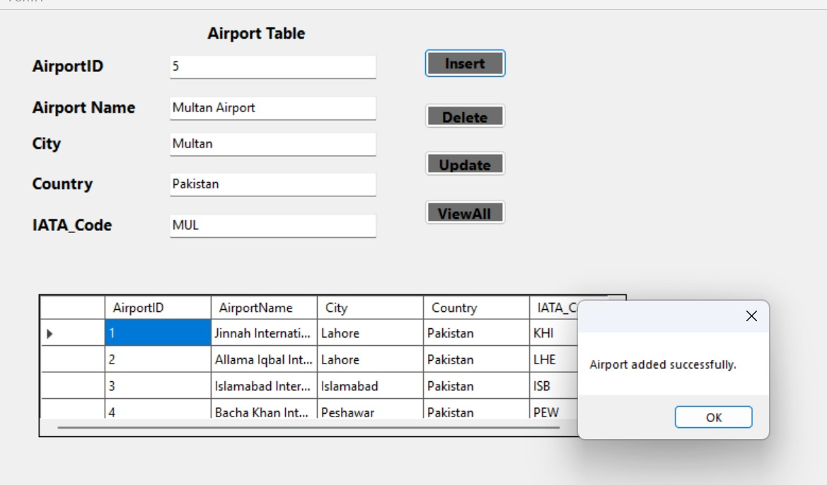
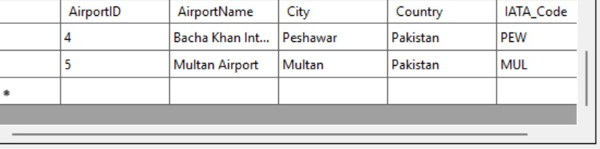

Slide 36
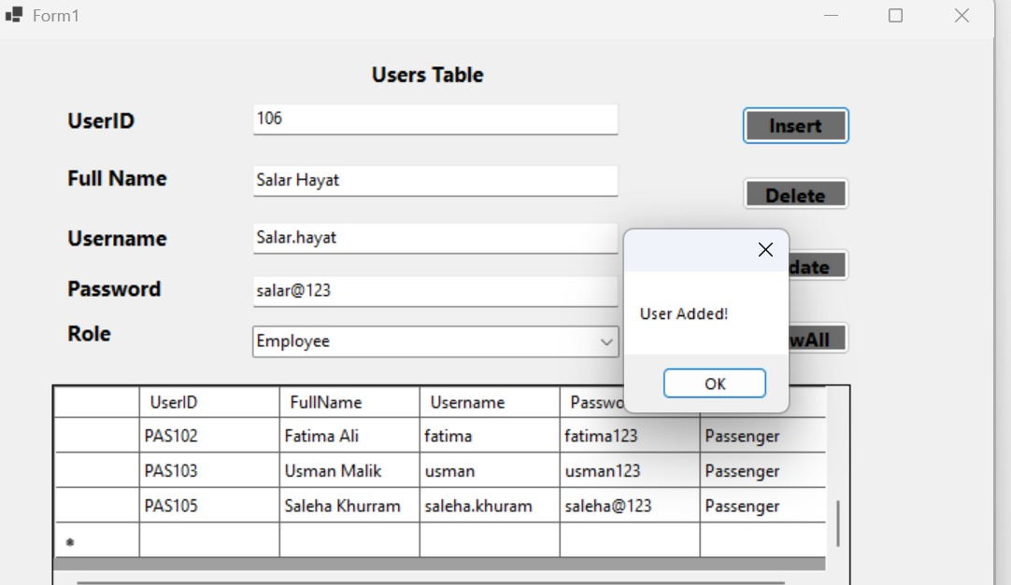
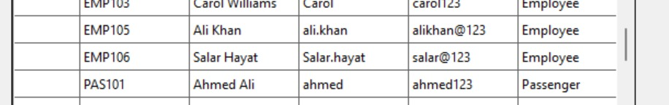

Slide 37
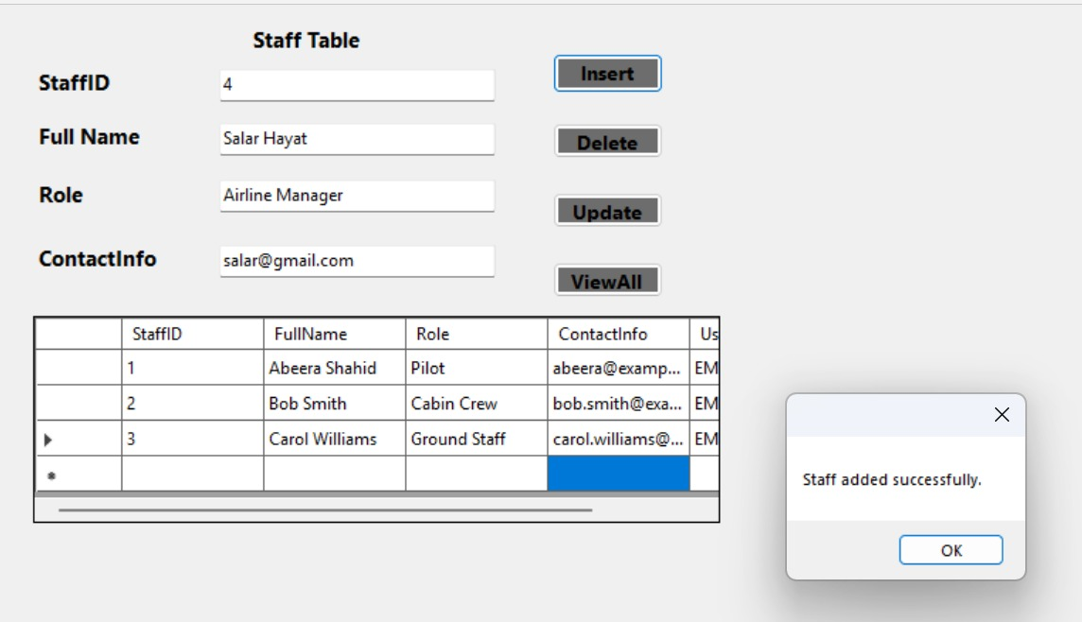
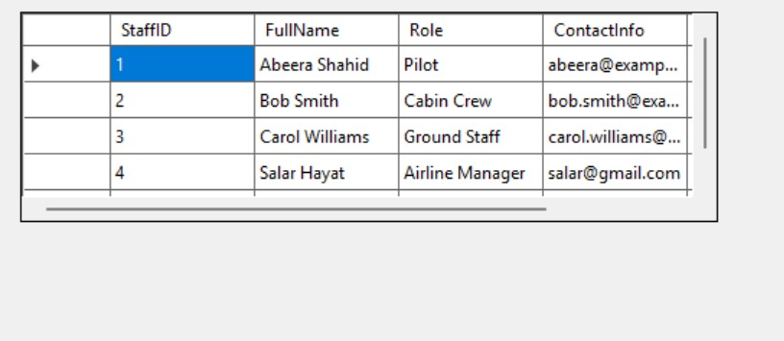

Slide 38
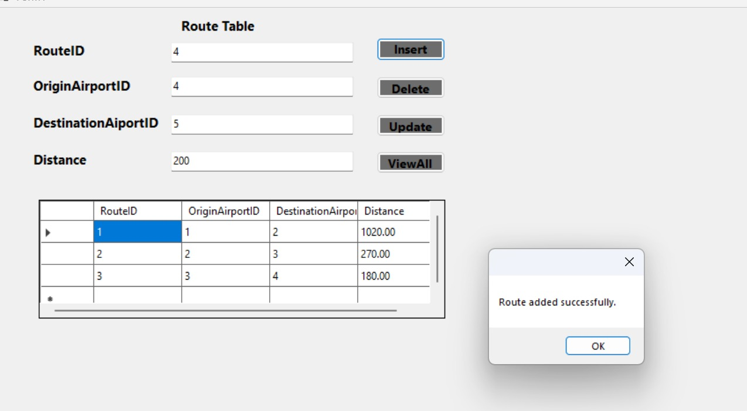
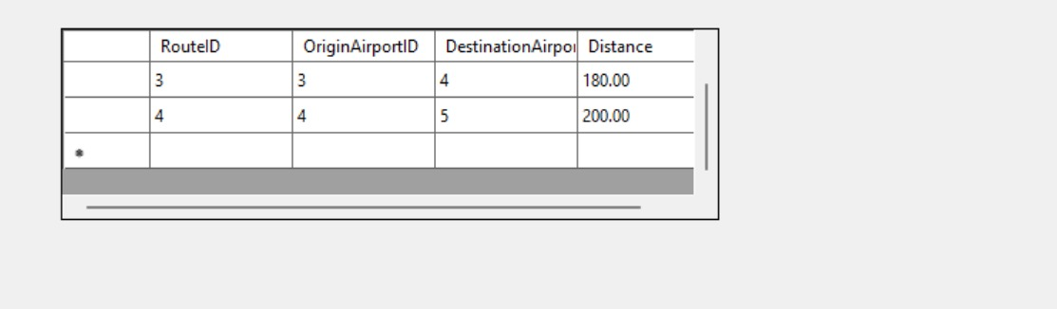

Slide 39
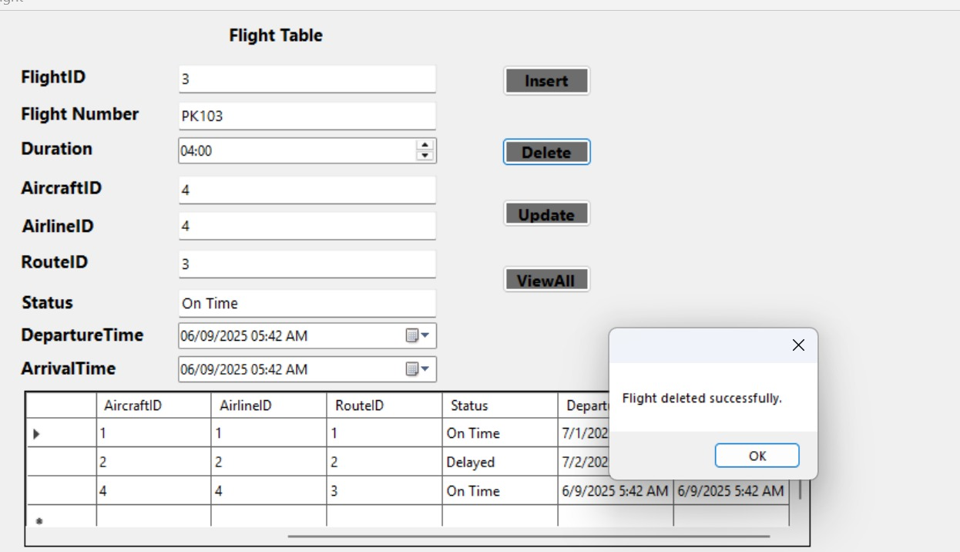
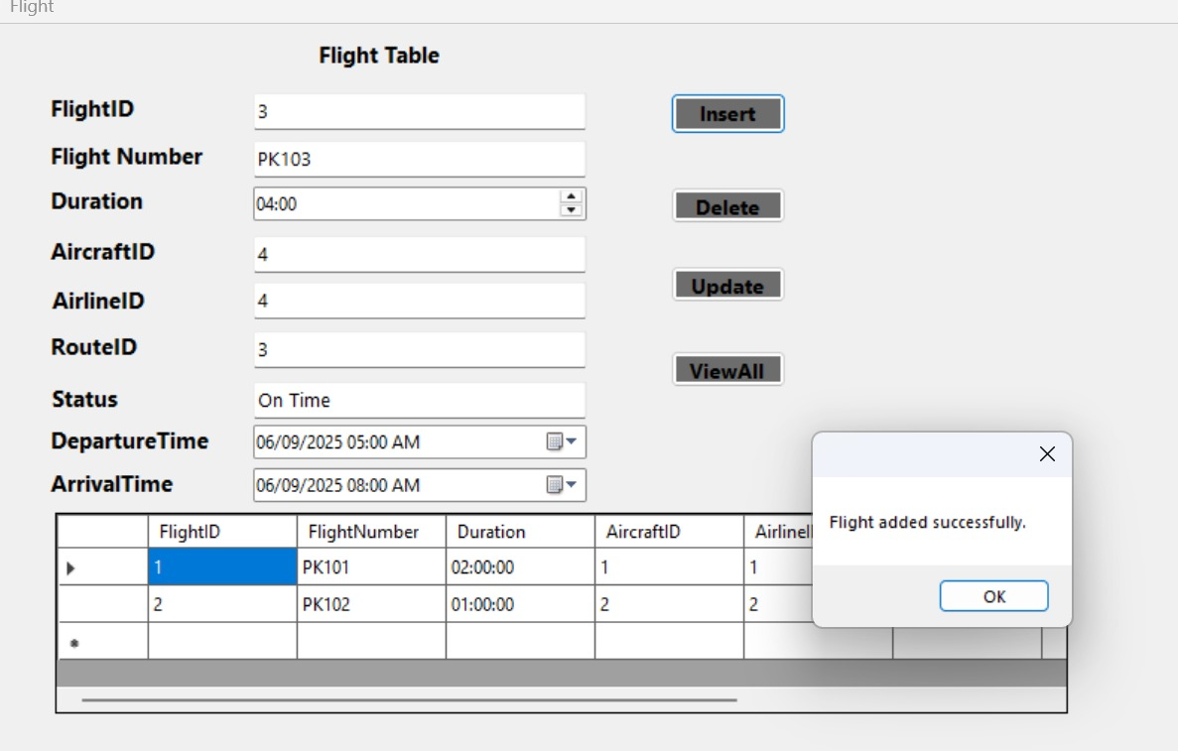

Slide 40
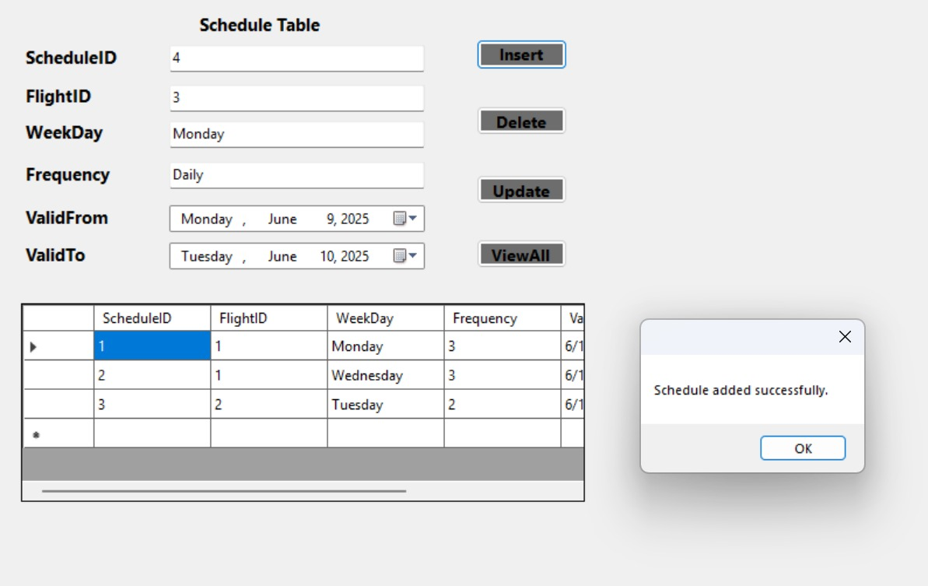
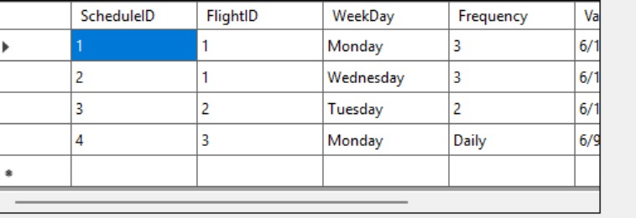

Slide 41
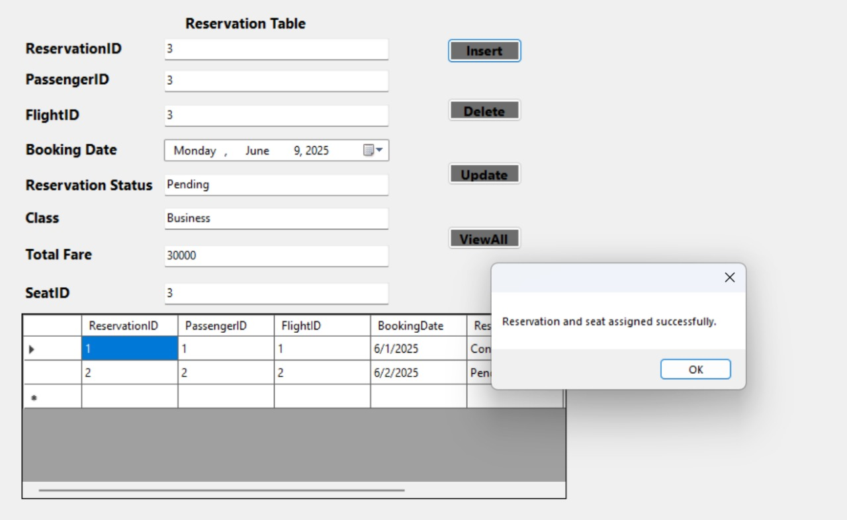
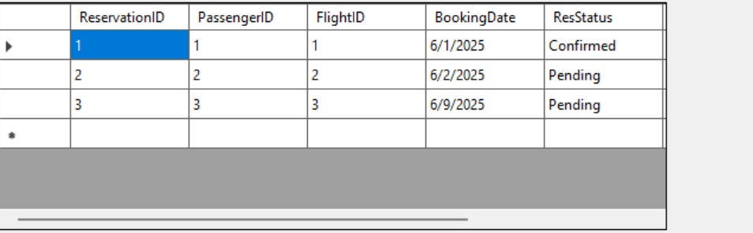

Slide 42
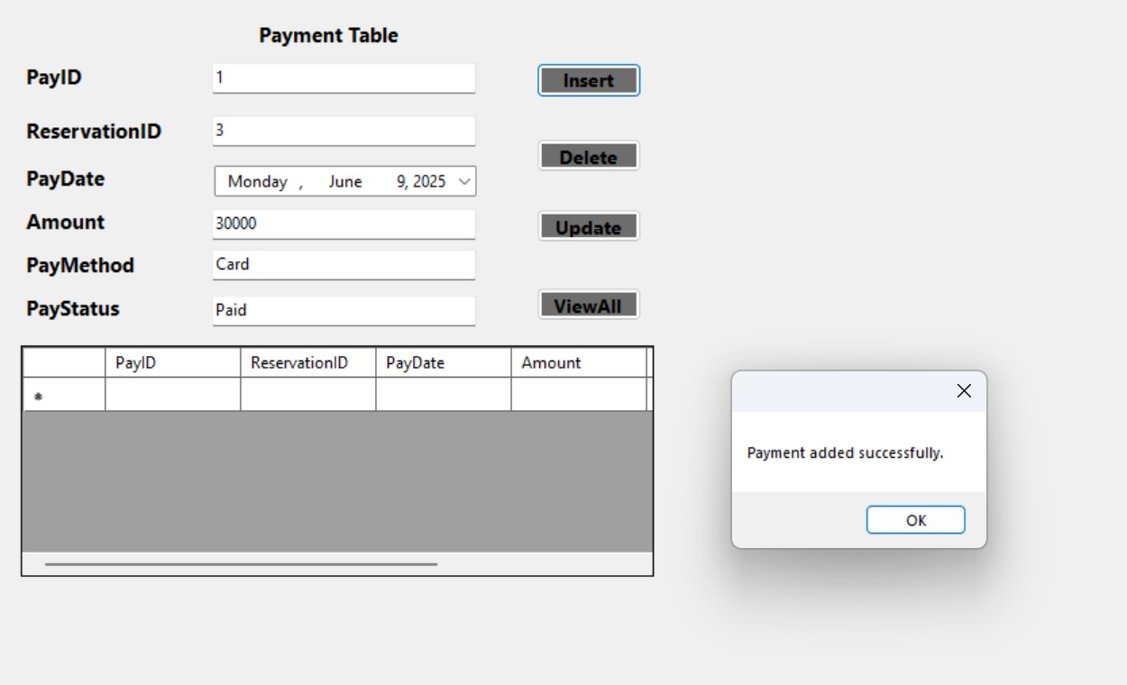
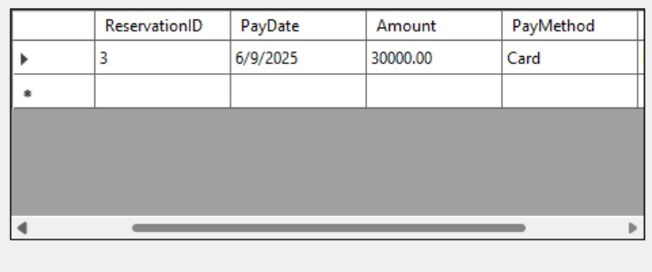

Slide 43
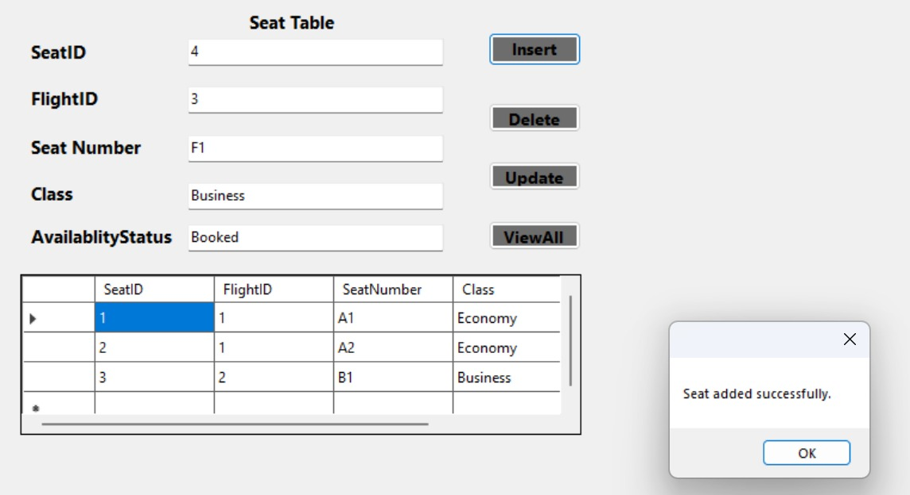
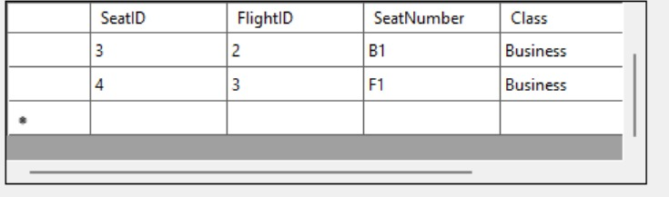

Slide 44
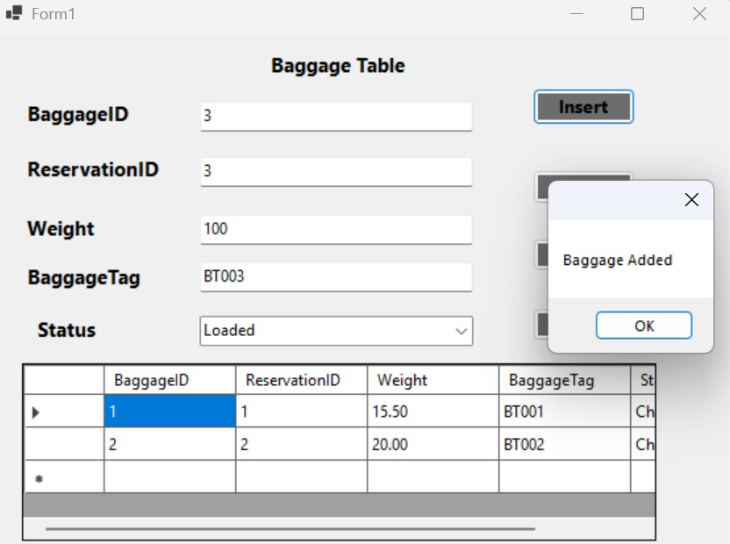
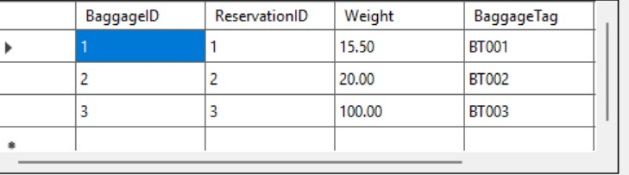

Slide 45



Slide 46


Slide 47





Slide 48







Slide 49


Slide 50



Slide 51



Slide 52

Some functionalities of Employee are same as that of admin as:
Manage BoardingPass,Manage Reservation ,Manage Flights,Manage Baaggage Handling,Assign Seats,Manage payments

Slide 53
Challenges and Solutions in the Airline Reservation System (Database and GUI Combined):
GUI-Specific and Integration Challenges
User Experience (UX) and Navigation:
Challenge: Designing an intuitive and easy-to-navigate interface for different user roles (Admin, Passenger, Employee), each with distinct functionalities, was complex. Without clear navigation, users could become lost or struggle to perform tasks.
Solution: The GUI was designed with clear, role-based menus and dedicated welcome pages (e.g., "Welcome Admin!", "Welcome User", "Welcome Employee"). Buttons and forms were logically grouped to guide users through workflows (e.g., "Search Flights" leading to "Book Ticket"). Consistent layout and visual cues were used across different forms.
Frontend Data Validation and User Feedback:
Challenge: Preventing invalid or incomplete data from reaching the database, and providing immediate, clear feedback to the user on input errors, was a significant challenge.
Solution: Client-side validation was implemented in the GUI for input fields (e.g., checking for empty fields, correct date formats, valid email patterns). Pop-up messages were used to inform users about successful operations (e.g., "Signup successful!", "Airline added successfully!") or errors (e.g., "Invalid login credentials").

Slide 54
Challenges and Solutions in the Airline Reservation System (Database and GUI Combined):
Real-time Data Synchronization:
Challenge: Ensuring that the data displayed on the GUI was always up-to-date with the database, especially in scenarios like seat availability or flight status, was critical.
Solution: Mechanisms were implemented to refresh data displayed in tables (e.g., DataGridView in the provided example) after any INSERT, UPDATE, or DELETE operation. This ensured that changes made by one user (or an administrative action) were reflected promptly for others viewing the same information.
Security and Role-Based Access Control:
Challenge: Protecting sensitive information (like user passwords) and ensuring that users could only access functionalities relevant to their assigned role (e.g., a passenger cannot manage flights) was paramount.
Solution: Password hashing was implicitly handled by the system's underlying security practices (though not explicitly detailed in the DDL/DML for Users). Role-based access control was implemented, where the GUI presented different menus and functionalities based on the user's Role determined during login (e.g., "Admin," "Employee," "Passenger"), restricting unauthorized actions.
By systematically addressing these challenges, the project delivered an integrated Airline Reservation System where the GUI served as an effective and intuitive interface for managing a robust and reliable database backend.

Slide 55
Conclusion:
This project successfully implemented a comprehensive Airline Reservation System, integrating a robust database backend with an intuitive Graphical User Interface (GUI) to manage all essential aspects of airline operations. The database, built using Microsoft SQL Server, adheres to relational principles through ER modeling, normalization, and a structured schema of interrelated tables. This design ensures data integrity, efficiency, and consistency for flight scheduling, passenger reservations, staff assignments, payment processing, seat allocation, and baggage handling. The effective use of Data Definition Language (DDL) for schema creation and Data Manipulation Language (DML) for data operations, including insertion, updates, deletions, subqueries, joins, and aggregate functions, demonstrates a strong foundation in database management and real-world problem-solving.
The accompanying GUI serves as a user-friendly visual interface, enabling seamless interaction with the underlying database system. Different user roles—Admin, User (Passenger), and Employee—are provided with tailored functionalities through dedicated welcome pages and forms. For instance, the GUI facilitates flight searches, ticket bookings, payment processing, profile management, and viewing boarding passes for users, while administrators and employees can manage flights, users, staff, reservations, and baggage handling directly through visual components. The integration ensures that all user actions on the frontend translate into corresponding database operations, maintaining data consistency and security. This project significantly enhanced the understanding of database design, normalization, data manipulation, and the critical role of a well-designed interface in large-scale systems like airline reservation platforms. Future enhancements could include advanced features like triggers, stored procedures, or views to further automate and strengthen the system.

Slide 56
References:
Book Database Systems - A Practical Approach to Design, Implementation, and Management
SIXTH EDITION
Thomas Connolly & Carolyn Begg.
Course Slides and Lectures: Supported database concepts, ER diagrams, and SQL implementation.
Pakistani Airport and Airline Data: Real-world data was referenced from official Pakistani airline and airport websites for project realism and localization

Slide 57

Thank You!

